Slide 1
Introduction to ASP .Net Framework
Course Code: CSC 4164
Course Title: ADVANCED PROGRAMMING WITH .NET
Dept. of Computer Science
Faculty of Science and Technology
Lecture No: | 02 | Week No: | 01 | Semester: | Summer 2020-21
Lecturer: | Tanvir Ahmed, tanvir.ahmed@aiub.edu

Slide 2
Lecture Outline
Overview of .NET Architecture
Introduction to ASP.Net Framework
Introduction to Visual Studio

Slide 3
Overview of .NET
.NET Architecture
What is .NET Framework
The .Net framework is a software development platform developed by Microsoft.
The framework was meant to create applications, which would run primarily on the Windows Platform.
The first version of the .Net framework was released in the year 2002.
The .Net framework can be used to create any kind of applications - Form based, Web based, Mobile applications

Slide 4
Overview of .NET
.NET Architecture
VB
C++
C#
JScript
…
Common Language Specification
Enormous platform
Over 10000++ types
Well-defined sub-systems and partitioning of responsibility
ASP.NET: Web Services
and Web Forms
Windows Forms
Visual Studio.NET
ADO.NET: Data and XML
Base Classes
Common Language Runtime

Slide 5
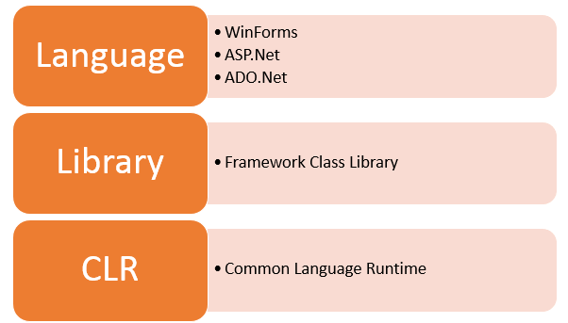
Overview of .NET
.NET Architecture
.Net Framework Architecture

Slide 6
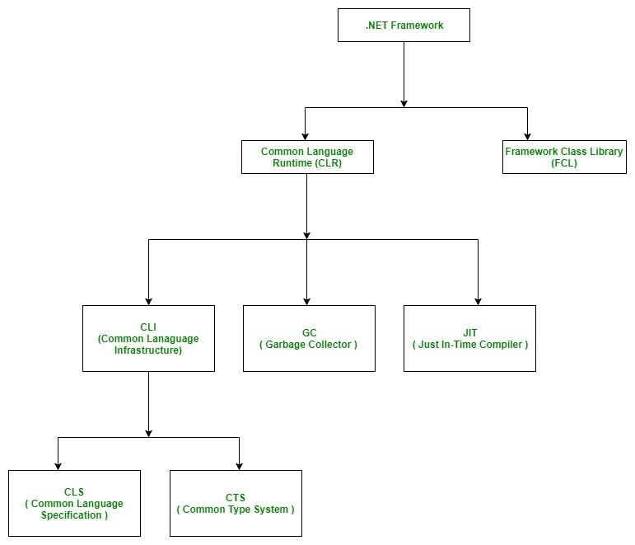
Overview of .NET
.NET Architecture

Slide 7
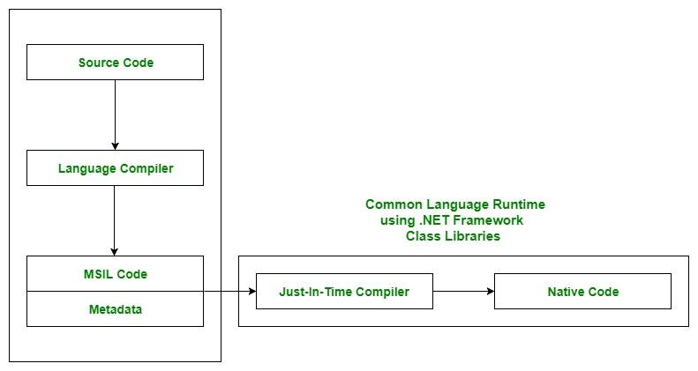

Slide 8
.NET Execution Model
Source code
Visual Basic
C#
C++
Unmanaged
Component
Compiler
Compiler
Compiler
Managed
code
Assembly
IL Code
Assembly
IL Code
Assembly
IL Code
Common Language Runtime
JIT Compiler
Native Code
Operating System Services

Slide 9
MSIL, IL & JIT
Microsoft Intermediate Language (MSIL), the intermediate code produced by the compiler after compiling the source code. This intermediate code is known as MSIL.
Intermediate Language (IL) is also known as MSIL (Microsoft Intermediate Language) or CIL (Common Intermediate Language).
Just In-Time Compiler (JIT), responsible for converting the CIL(Common Intermediate Language ) into machine code using the Common Language Runtime environment.
Common Language Runtime (CLR) provides an environment to execute .NET applications on target machines. The responsibilities of CLR are listed as follows:
Automatic memory management
Garbage Collection
Code Access Security
Code verification
JIT compilation of .NET code

Slide 10
According to Wiki…
In computer programming, a software framework is an abstraction in which software providing generic functionality can be selectively changed by additional user-written code, thus providing application-specific software. It provides a standard way to build and deploy applications and is a universal, reusable software environment that provides particular functionality as part of a larger software platform to facilitate development of software applications, products and solutions.

Slide 11
Introduction to ASP.Net Framework
What is .NET Framework?
.NET is a platform for the developers made up of tools, programming languages and libraries. The framework is a complete environment that allows developers to develop, run and deploy applications such as:
Console applications.
Windows Forms applications.
Windows Presentation Foundation (WPF) applications.
Web applications (ASP.NET applications).
Web services.
Windows services and some more.

Slide 12
The main components of .NET Framework
.NET Framework Class Library
Common Language Runtime
Dynamic Language Runtimes (DLR)
Application Domains
Runtime Host
Common Type System
Metadata and Self-Describing Components
Cross-Language Interoperability
.NET Framework Security
Profiling
Side-by-Side Execution

Slide 13
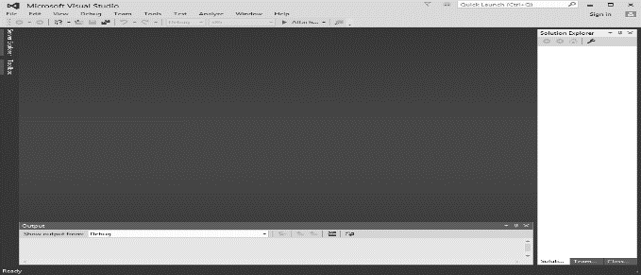
Introduction to Visual Studio
Visual Studio is an IDE (integrated development environment) for building apps. Similar to using Microsoft Word to write documents, you’ll use Visual Studio to create web apps.

Slide 14
Visual Studio
VS supports multiple languages (C#, C++, Visual Basic, J#) in one IDE.
VS manages features and content in a convenient way.
All Visual Studio .NET languages are object-oriented.
All programs have a similar structure.
All programs compiled into Common Intermediate Language (CIL)
For this course at least Visual Studio 2013

Slide 15
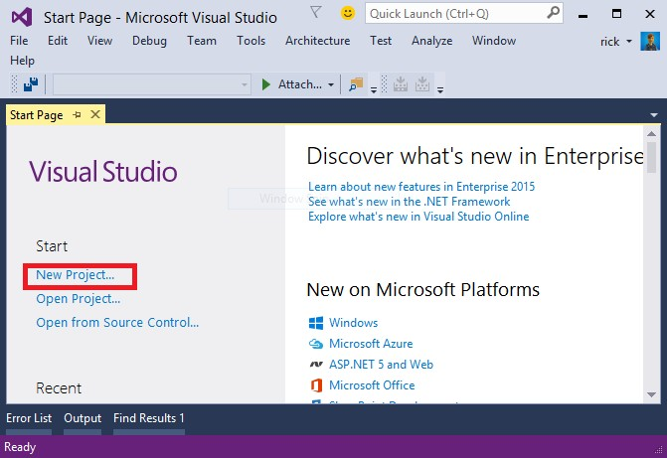
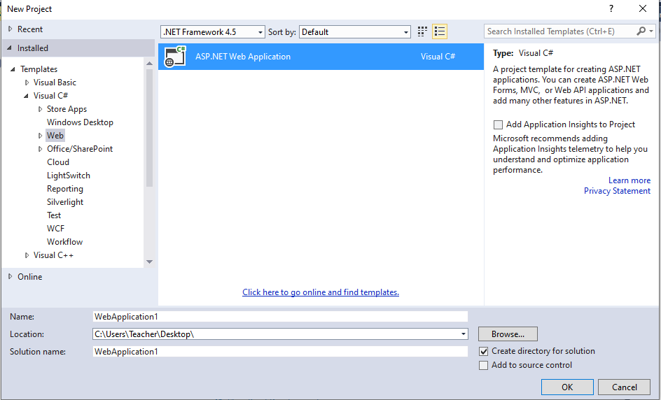
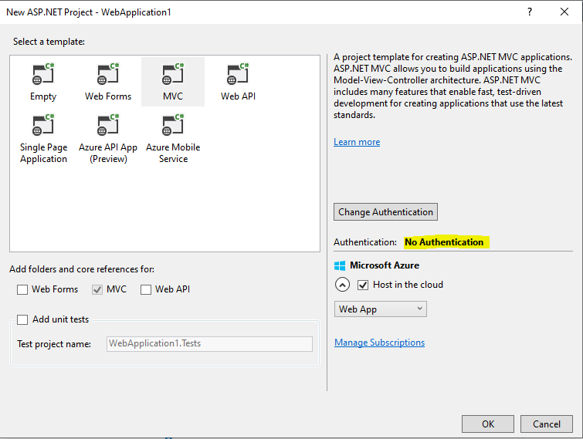
Creating a web application
1
2
3

Slide 16
Books
Visual Studio from the Microsoft Developer Network (MSDN) https://msdn.microsoft.com/enus/library/dd831853(v=vs.120).aspx (particularly note the Visual Studio IDE User Guide and the Application Development in Visual Studio links).
C# 4.0 The Complete Reference; Herbert Schildt; McGraw-Hill Osborne Media; 2010
Beginning ASP.NET 4: in C# and VB; Imar Spaanjaars,2010

Slide 17
References
ASP.NET; URL: https://dotnet.microsoft.com/apps/aspnet
.NET Architecture; URL: https://www.geeksforgeeks.org
URL: https://www. tutorialspoint.com/index.htm

Slide 18
Thank you!

